Slide 1
Refactoring/cleanup for External Centralized Form Processor CloudPage
GEE-72810
Developer: Himanshu Gupta

Slide 2
Overview
GEE-72810 - Refactoring/cleanup for External Centralized Form Processor CloudPage
    Description
    As the lead for data management, I want the External Centralized Form Processor CloudPage code to be refactored and cleaned up per a previous Spike (GEE-35446), so that we can improve processing performance and development process.
    Additionally, the data management team reported 404 Error experienced by Anteriad while posting leads to the External Centralize Form Processor: INC4979312
    Contact Point Email record already existed in Salesforce for the submitted email address. During processing, the Centralized Form Processor (CFP) attempted to perform the standard Contact Point Email lookup to identify an existing Contact/Lead and retrieve associated consent information. However, at the time of processing, the required Salesforce data was not returned to CFP. As a result, no Salesforce ID was obtained, and CFP followed the new Lead creation path. Salesforce subsequently rejected the Lead creation request because the email address already existed in Contact Point Email.
    External CFP will be enhanced to handle scenarios where an existing Contact Point Email record is not returned during the lookup process. Additional checks will be put in place prior to attempting to create a new lead.
Marketing Cloud Updates​
Cloud Page: CentralizedFormProcessor-External (Existing)
Notes:
This enhancement focuses on refactoring and cleaning up the External Centralized Form Processor CloudPage to improve maintainability, reliability, and performance.
The change was initiated based on the recommendations from the earlier spike GEE-35446 and an issue reported by Anteriad where certain form submissions resulted in a 404 error due to Contact Point Email lookup inconsistencies in Salesforce.
In some scenarios, the Contact Point Email record existed in Salesforce, but the required Salesforce data was not returned during processing. This caused the application to incorrectly follow the new lead creation path, which was then rejected by Salesforce as a duplicate.
To address this, additional validation and lookup checks were introduced before attempting lead creation, making the solution more resilient and reducing the likelihood of processing failures.

Slide 3
Cloud Page: CentralizedFormProcessor-External
The CentralizedFormProcessor-External CloudPage has been enhanced to perform the following functions:
• Read and process all incoming parameters received from external form submissions, including contact details, company information, marketing attribution fields, preferences, campaign data, and form metadata.
• Generate and assign a unique tracking identifier (GUID-based Primary Key with EX- prefix) for each form submission to support audit, tracking, and traceability requirements.
• Perform comprehensive field length validation across all submitted parameters to ensure data complies with defined Data Extension field limits and prevent truncation, malformed submissions, or potential injection attempts.
• Execute special character validation and script pattern detection across submitted fields and URL parameters, rejecting submissions containing unauthorized characters or suspicious script content.
• Create a staging record in the NoSFID_CentralizedFormProcessor Data Extension to ensure submissions are captured before Salesforce processing begins.
• Perform Salesforce Lead and Contact resolution by searching ContactPointEmail records, synchronized ContactPointEmail data, and Individual relationships to identify existing person records associated with the submitted email address.
• Promote successfully processed records into the Centralized_Form_Processor_DE Data Extension, including the associated Salesforce ID, and remove the corresponding staging record after successful promotion.
Notes:
This slide highlights the key capabilities of the enhanced External Centralized Form Processor CloudPage.
The CloudPage now processes all incoming form parameters, generates a unique tracking identifier for every submission, and performs comprehensive validation checks to ensure data quality and security.
Additional validations include field length checks, special character validation, and script detection to prevent malformed submissions and potentially malicious input.
The solution also stages records for processing, performs Salesforce Lead and Contact resolution using Contact Point Email data, and promotes successfully processed submissions into the Centralized Form Processor Data Extension with the associated Salesforce ID.

Slide 4
Cloud Page: CentralizedFormProcessor-External (Contd.)
• Update Salesforce consent status by setting eligible Lead and Contact records to Opt In status and remove related unsubscribe records where required.
• Synchronize suppression management by removing qualifying email addresses from Global Suppression and Unsubscribe Data Extensions when consent is restored.
• Process associated email addresses linked to the same Salesforce person record and reactivate their subscription status where applicable.
• Securely retrieve and decrypt API credentials required for authenticated Marketing Cloud API integrations and Journey Builder event processing.
• Dynamically trigger Journey Builder entries based on form configurations, business unit mappings, and journey event key configurations without using hard-coded event identifiers.
• Return a success response upon successful processing, either as a JSON response or by redirecting the user to a configured confirmation page.
• For any validation, Salesforce integration, consent management, preference processing, journey execution, data insertion, or system error, capture submission details and insert an error record into the Centralized_Form_Processor_DE_Error_Log Data Extension to support troubleshooting, monitoring, and audit requirements.
Notes:
Beyond validation and Salesforce resolution, the CloudPage also manages consent and subscription synchronization.
When appropriate, Salesforce Lead or Contact records are updated to Opt In status, and associated suppression or unsubscribe records are removed to ensure marketing preferences remain aligned across systems.
The solution securely retrieves API credentials, supports dynamic Journey Builder triggering without hard-coded event identifiers, and returns a success response once processing is completed.
In addition, robust error handling has been implemented. Any validation, integration, consent, or journey processing failure is logged in the Centralized_Form_Processor_DE_Error_Log Data Extension to support troubleshooting, monitoring, and auditing.

Slide 5
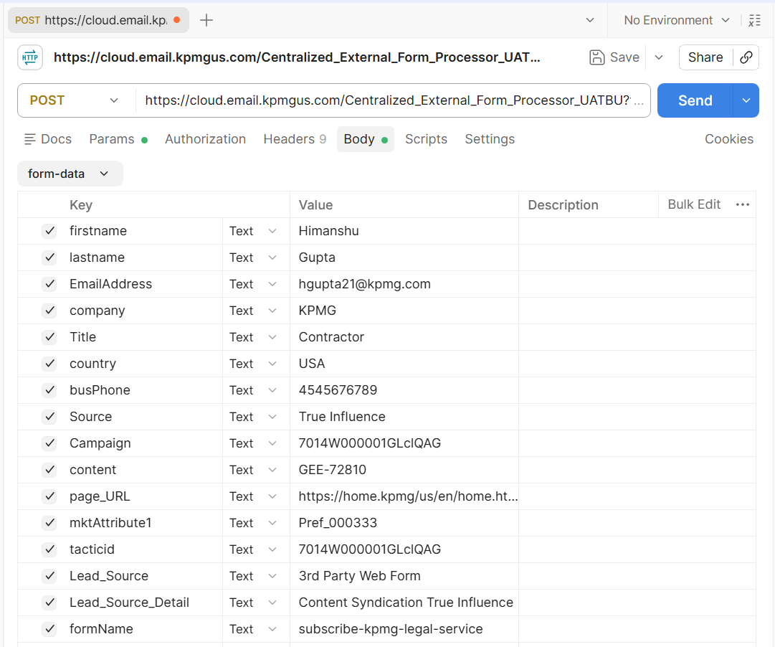
Test Results
Set the required field values
in the payload and send the
request using a POST request
in Postman.
Notes:
For testing, all required form parameters were configured in Postman and submitted to the External Centralized Form Processor endpoint using a POST request.
The test payload included contact information, campaign details, form metadata, and preference-related values to simulate a real-world external form submission.
This test validates the end-to-end processing path from initial submission through Salesforce resolution, preference processing, and journey injection.

Slide 6
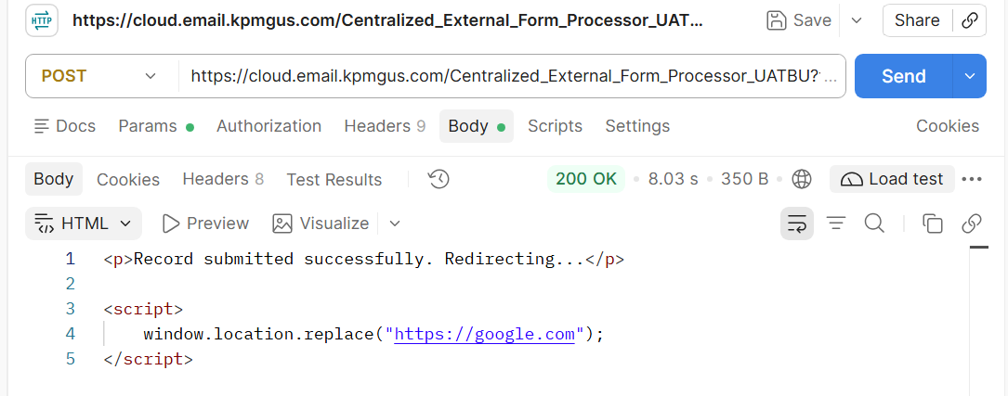
Test Results
The request was submitted successfully, and a 200 OK response was received from the API.
Notes:
This slide shows the successful API response received after submitting the request. A 200 OK status confirms that the request was processed successfully without any errors.
As part of the refactoring effort, we also observed a significant performance improvement. The end-to-end processing time was reduced from approximately 16 seconds to around 8 seconds. This represents roughly a 50 percent reduction in processing time and provides a faster experience for external form submissions.
The improved performance was achieved through code optimization, cleanup activities, and more efficient processing logic introduced during the enhancement.

Slide 7
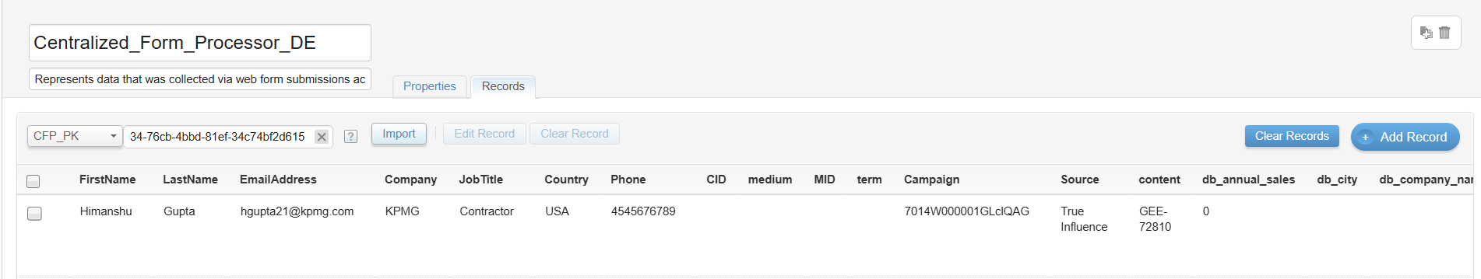
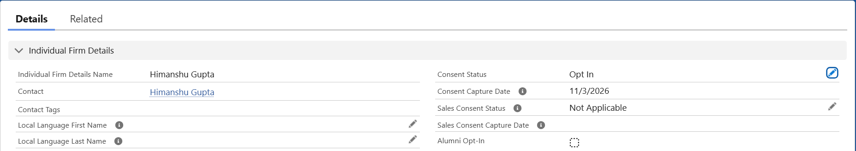
Test Results
After an external form submission, the record is inserted into the Centralized_Form_Processor_DE, and the Sales Cloud consent status is also updated to Opt In.
Notes:
After submission, the record was successfully processed and inserted into the Centralized_Form_Processor_DE.
The screenshots demonstrate that the Salesforce consent status was also updated to Opt In as part of the processing workflow.
This confirms that the solution successfully completed both data capture and consent management activities within Sales Cloud and Marketing Cloud.

Slide 8
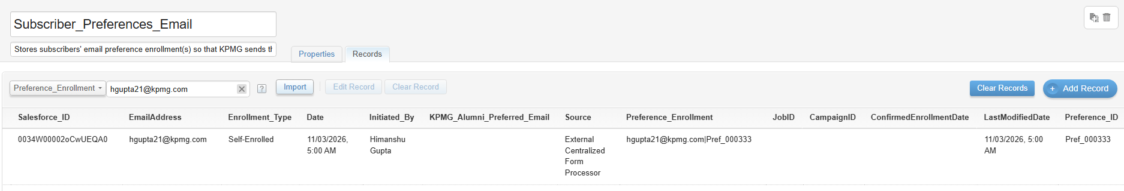
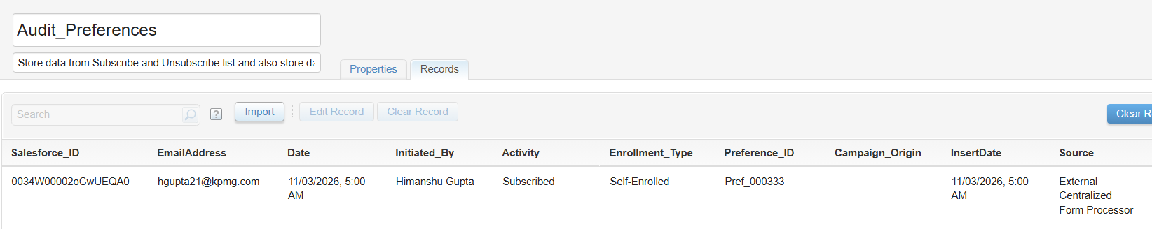
Test Results
The record is processed successfully and inserted into the corresponding preference-related Data Extensions based on the submitted preferences.
Notes:
This slide demonstrates that the submitted preferences were processed successfully and routed to the Subscriber_Preferences_Email Data Extension and Audit_Preferences Data Extension.
This validates that preference management functionality continues to operate correctly following the refactoring effort.

Slide 9
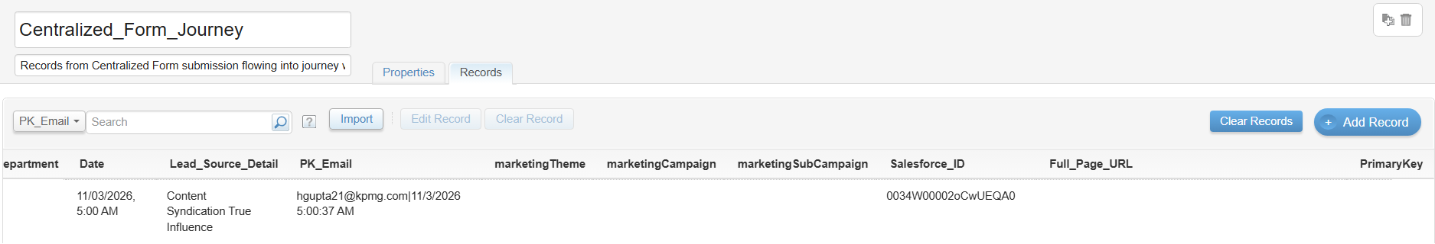
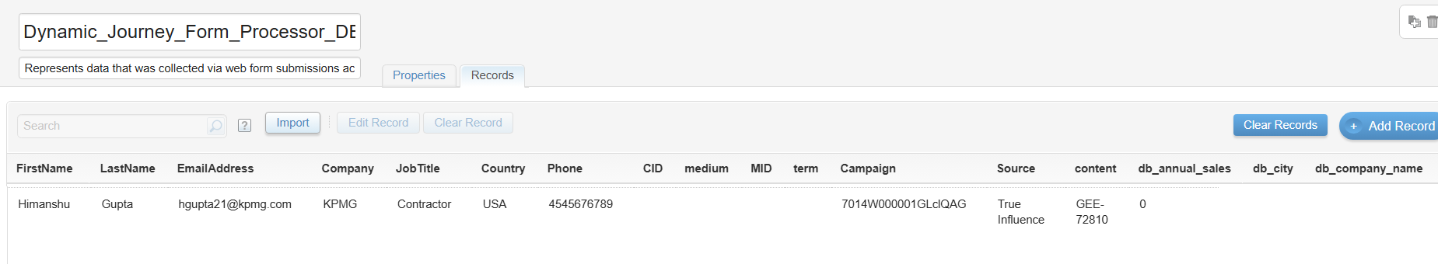
Test Results
In addition to the preferences Data extension, the record is processed successfully and inserted into the corresponding CFP journey entry data extension and Dynamic_Journey_Form_Processor_DE.
Notes:
In addition to the preference Data Extensions, the submission was also inserted into the CFP journey entry Data Extension and the Dynamic_Journey_Form_Processor_DE.
These records are used to support downstream journey orchestration and dynamic journey processing requirements.
The successful insertion confirms that journey qualification logic executed correctly and that all required data was prepared for journey entry.

Slide 10
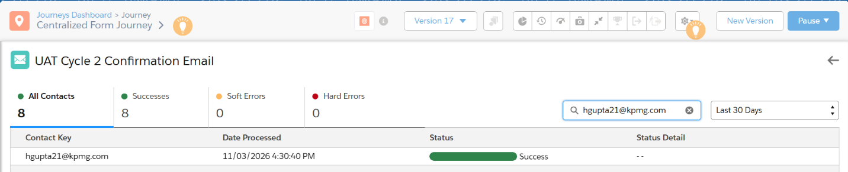
Test Results
The record has been successfully injected into the Centralized Form Journey.
Notes:
The final validation step confirms that the record was successfully injected into the Centralized Form Journey.
The journey accepted the submission and the contact entered the configured journey path without any processing errors.
This demonstrates successful end-to-end execution, starting from the external form submission, through validation and Salesforce processing, all the way to Journey Builder entry.

